Slide 1
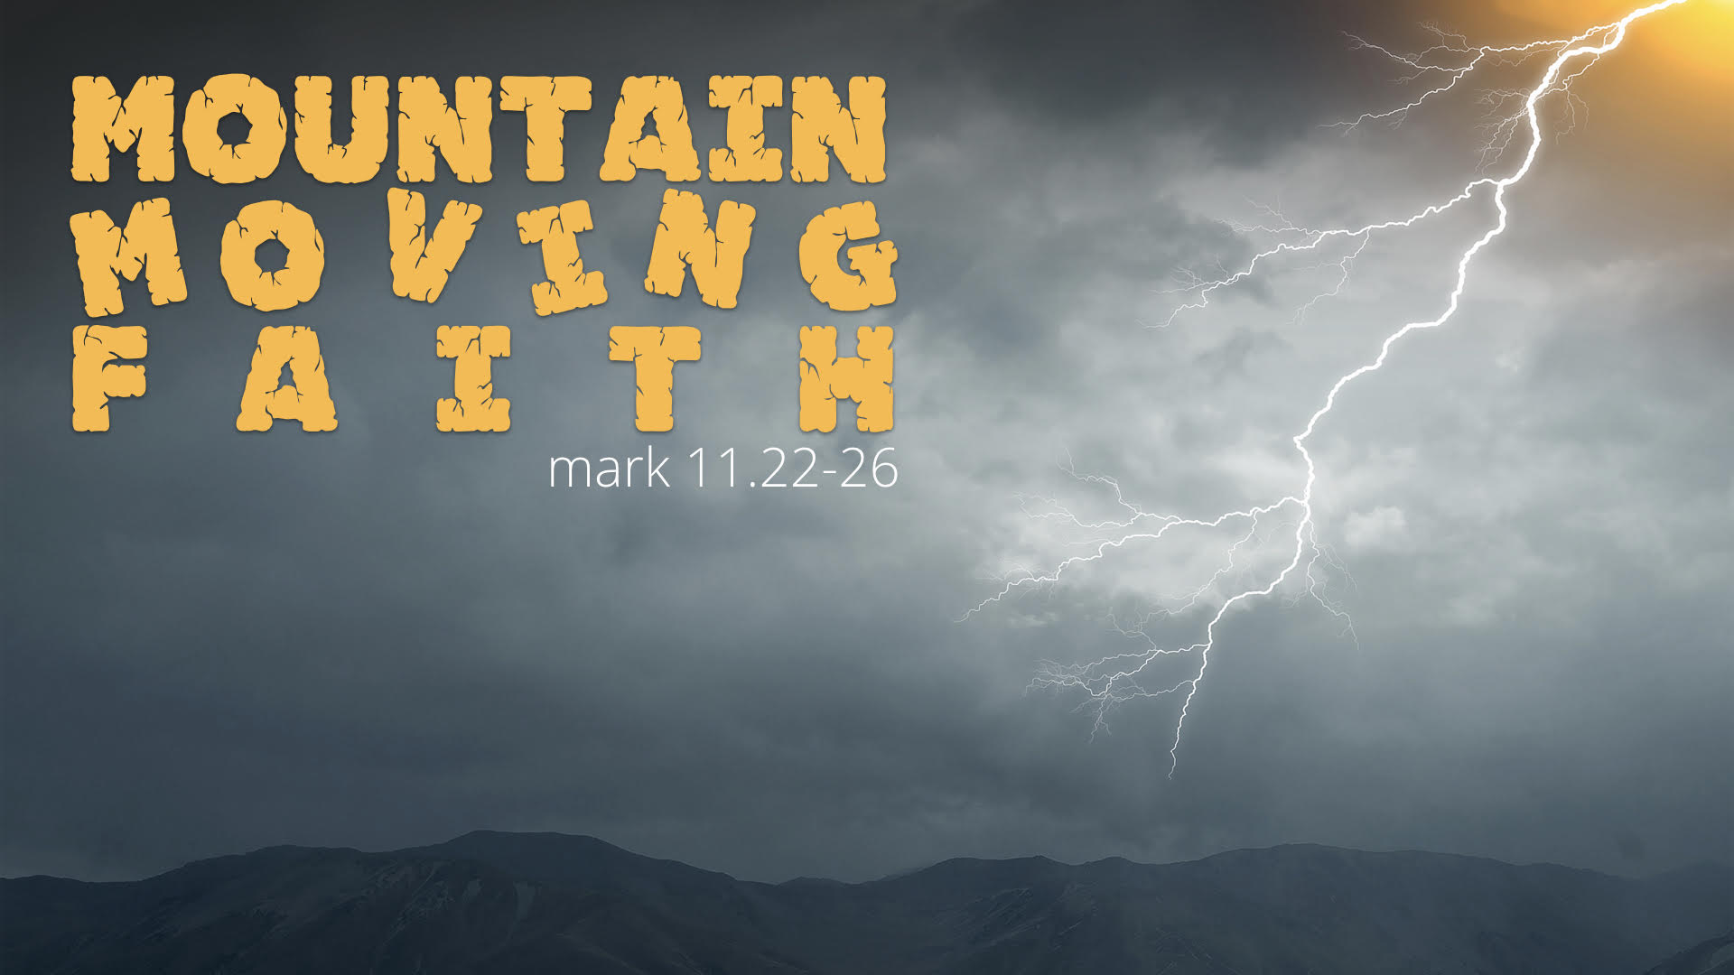

Slide 2
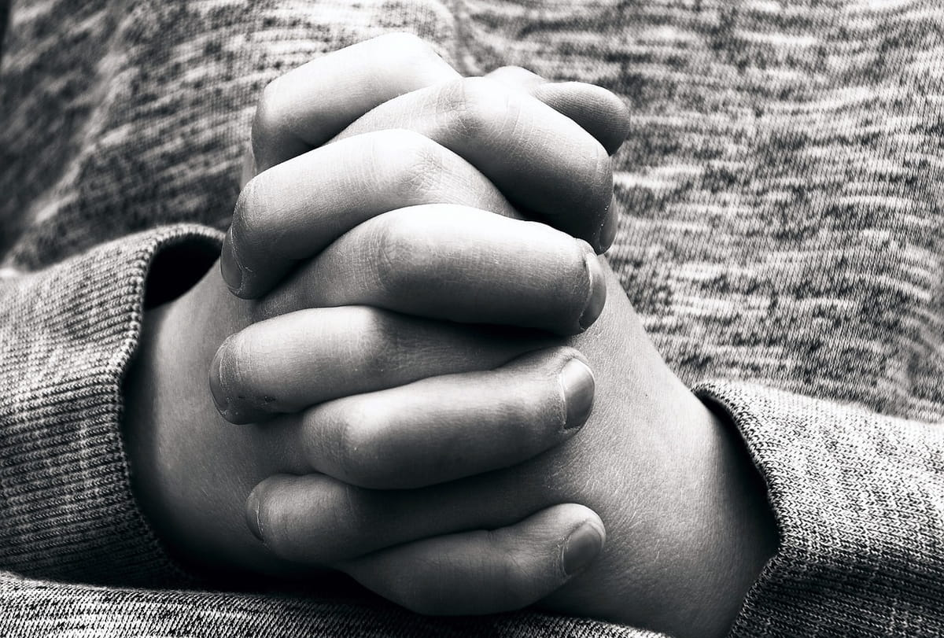
Faith Expressed in Praising Prayer

Slide 3


Slide 4
Mountain Moving Faith
Faith in God
Faith in God’s Promises
Faith Expressed in praising prayer
Notes:
Today we're going to look at 'Faith Expressed In Praising Prayer' - alright? So 'Faith in God', 'Faith in God's Promises', 'Faith Expressed in Praising Prayer'. This is vital. There is a quote attributed to Archimedes - do you know who Archimedes was? Who knows who Archimedes was? What? Was he? I thought he was a mathematician. Did you know there are only three types of people in the world? Those who are good at maths, and those who aren't! Oh the penny has dropped over there - he's got it! Well, Archimedes said: 'Give me a place to stand on, and I will move the earth'. Have you heard that before? This was the concept of mathematics and physics that is of course true, that if you have a lever, and you have the right place to stand on with that influence, you can move anything. Having a firm place to put your feet on, anything is possible. Now, if our feet are on the truth of God, the word of God, and God communicating that to us in our own personal experience - and that's what matters, I mean the Bible tells us how to be saved, but if we don't get saved, what does it matter? It's not doing us any good. So the promises in the Bible have to be taken by faith, and we've got to work out what God has worked in, potentially, into our lives - but that is the firm place on which we stand. We can move mountains if we have the right vantage point, and the right leverage - and the leverage is faith. Jesus said - it's a remarkable verse, and I'm not going to dwell too much on it, I'm going to look more at verse 24 - but look at verse 23: 'Assuredly, I say to you, whoever says to this mountain, 'Be removed and be cast into the sea', and does not doubt in his heart' - the only way that's possible is if God has told you that this mountain is going to move - 'does not doubt in his heart, but believes that those things he says will be done, he will have whatever he says'.

Slide 5
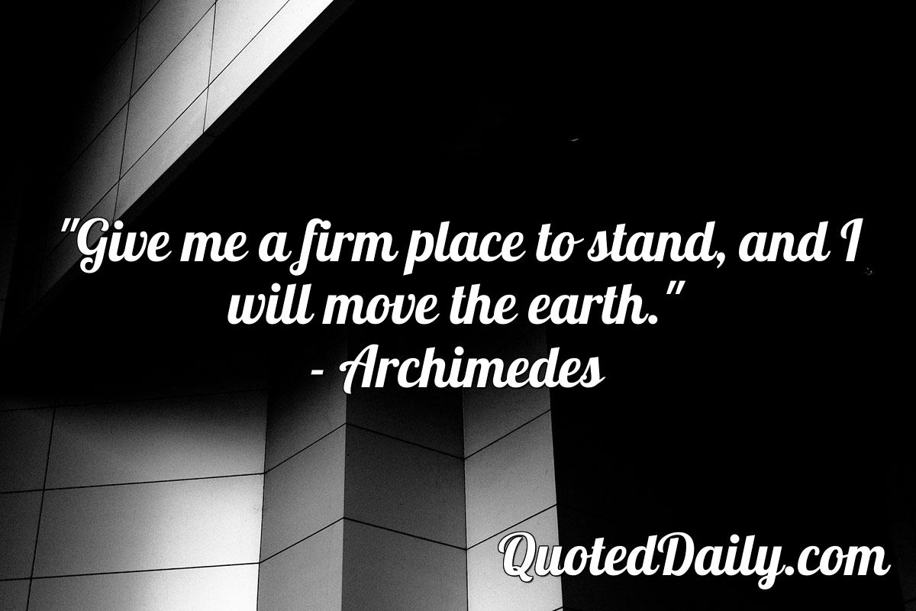
Notes:
Today we're going to look at 'Faith Expressed In Praising Prayer' - alright? So 'Faith in God', 'Faith in God's Promises', 'Faith Expressed in Praising Prayer'. This is vital. There is a quote attributed to Archimedes - do you know who Archimedes was? Who knows who Archimedes was? What? Was he? I thought he was a mathematician. Did you know there are only three types of people in the world? Those who are good at maths, and those who aren't! Oh the penny has dropped over there - he's got it! Well, Archimedes said: 'Give me a place to stand on, and I will move the earth'. Have you heard that before? This was the concept of mathematics and physics that is of course true, that if you have a lever, and you have the right place to stand on with that influence, you can move anything. Having a firm place to put your feet on, anything is possible. Now, if our feet are on the truth of God, the word of God, and God communicating that to us in our own personal experience - and that's what matters, I mean the Bible tells us how to be saved, but if we don't get saved, what does it matter? It's not doing us any good. So the promises in the Bible have to be taken by faith, and we've got to work out what God has worked in, potentially, into our lives - but that is the firm place on which we stand. We can move mountains if we have the right vantage point, and the right leverage - and the leverage is faith. Jesus said - it's a remarkable verse, and I'm not going to dwell too much on it, I'm going to look more at verse 24 - but look at verse 23: 'Assuredly, I say to you, whoever says to this mountain, 'Be removed and be cast into the sea', and does not doubt in his heart' - the only way that's possible is if God has told you that this mountain is going to move - 'does not doubt in his heart, but believes that those things he says will be done, he will have whatever he says'.

Slide 6

Notes:
We're going to home in on verse 24 here: 'Therefore I say to you, whatever things you ask when you pray, believe that you receive them, and you will have them'. One type of faith says 'God can', and that's pretty good because a lot of people are still at 'God can't' or 'God doesn't'; but another type of faith says 'God will'. Biblical faith is even better than that - did you know there was an alternative from 'God can' and 'God will'? It's this: God has. Now that's the type of faith that is spoken about here in verse 24: whatever you ask when you pray, believe that you receive them, and you will have them. You see, true biblical faith that moves mountains doesn't say, 'I'm going to get', but it says 'I have got' - I have it! Now that might initially seem new, but if you think about it: anybody can believe that you have something after you've received it - think about that. Is it such a big thing to believe that you've got something after you've received it? Of course it's not! That is walking by sight, not by faith. Biblical faith is believing that you have something before you have it. Now I know that's a contradiction, but let's say believing that you have it in spirit, before you actually tangibly see it in the natural and the physical.

Slide 7
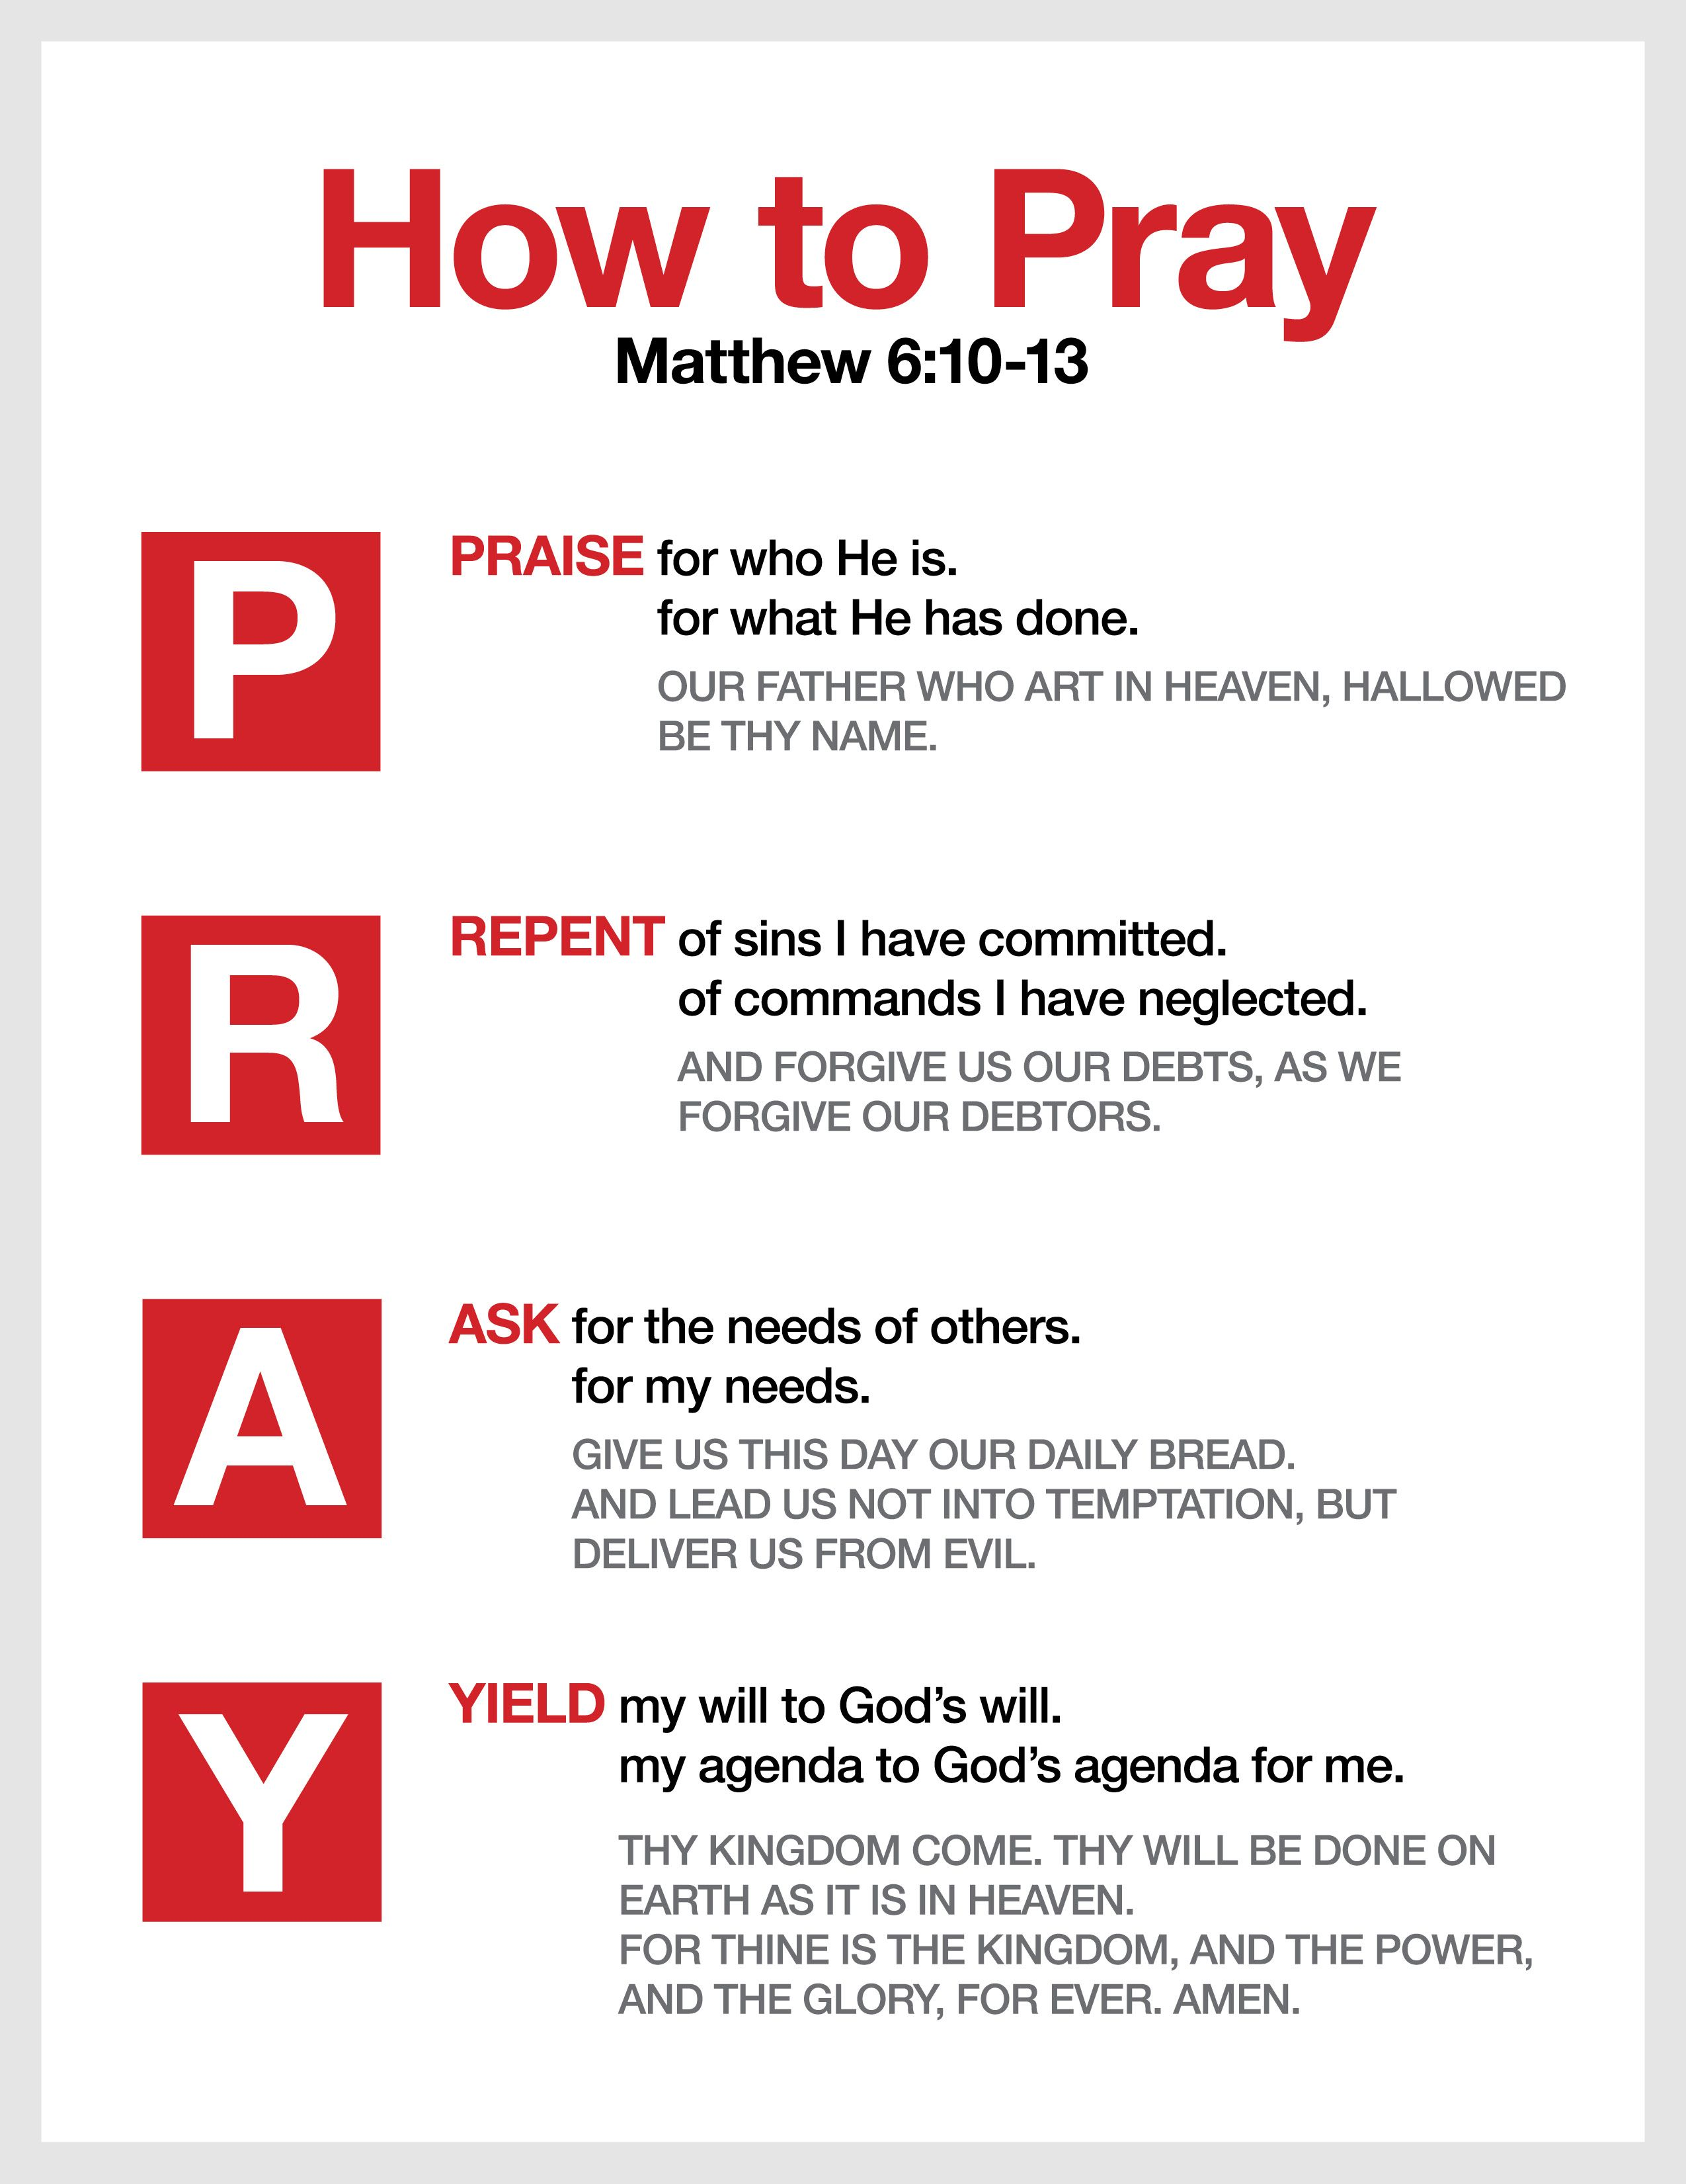
Notes:
So this, really, I believe, comes to the nub of one of the problems that we have - particularly in our prayer lives - as Christians. You know prayer is a struggle, and even corporate prayer, getting people together to pray - I mean it's not the easiest thing in the world to do. But even when you do motivate people to get together, often our prayers can be unbelief in disguise; where we are begging God - now don't misunderstand me, I believe in all the parables, and we will talk about them tomorrow, the importunate widow and the neighbor asking for bread and all that - I believe that we've got to ask, seek, and knock, and persevere, but we must not do that out of the vantage point of unbelief, that must be done through the perseverance of faith. The place on which you stand, like Archimedes, will determine the leverage that you get. Are you standing on a firm foundation, confident in the promise that God has given you, or are you standing on this sinking sand of unbelief - the more you lever, the more you sink? That is often how we pray - and you can discern it almost. There can be broken prayers, there can be really strong crying and tears like Jesus, but you know that they are prayers of faith that say: 'Lord, this world is crumbling around my ears, but I believe You and I will not be refused, and I will not allow what I'm seeing in the natural to pull me down and to rob me of what You have given me confidence of'.
Now praise God for that, and I believe God hears desperate prayers - but there are other prayers that are: 'Oh, Lord, please, my back is to the wall and everything is disastrous. Lord, Lord, Lord, where are You?'. I know we can pray honestly, I'm not suggesting we don't pray honestly, but if our prayers are continually this despairing, negative, pessimistic - of that type of spirit - we're not actually entering into faith. It often is disguised unbelief. So what I'm saying today is: our pleading - even if our pleading is in faith - our pleading has to turn to praising if we're going to see mountains move. It was George Mueller, that great man of faith who fed hundreds of thousands of orphans through faith - he was a remarkable man you know, a remarkable man - I mean, you want to read his biography. The stories that are there are incredible, of his faith, believing God. God had given him a promise that God would provide, but you know his faith wasn't just putting the breakfast on the table in the morning when there was not enough bread. This was a man who was able to go out on the deck of a boat and speak to the weather - and it changed! - when there was a storm coming. Now Mueller said: 'Here are two parts of sure-to-be-answered prayer' - so you want to listen to a guy like Mueller - 'two parts of sure-to-be-answered prayer. One: prayer for the promise' - OK? So you've got a scenario, and I know that I told you about the directory that I have from the Bible of all the promises in the Word - you could look up promises that God has given you, but maybe you're wanting to really know the thing is coming from God to your heart for this specific situation. You say: 'Lord, please give me a promise, confirm to me that this is Your promise'. Like Abraham, it might be that He speaks through the Word to your heart, but He will confirm it through another means as well - a threefold cord is not easily broken - maybe He confirms it through other people, maybe He confirms it through circumstances, various ways God can do that. When you're sure that you've got the promise, you've prayed for the promise, then you praise from the promise - OK?
So if you're not sure what God's will is in a certain area, what do we do? Generally we say, 'Lord, Your will be done', and that's a copout because that gets us out of the process of waiting on God. It's easy to say 'Your will be done', but He wants us to know what His will is - and to know what His will is, we have to wait on Him and we have to seek Him. So when He then gives us the promise and He confirms it, we then stop praying for it. But what we often do is we keep praying the promise, 'Lord, You gave me this promise and I ask that You will fulfill it' - but is He a liar? If He gave you a promise, why would you ask Him to fulfill it? He promised!

